Slide 1
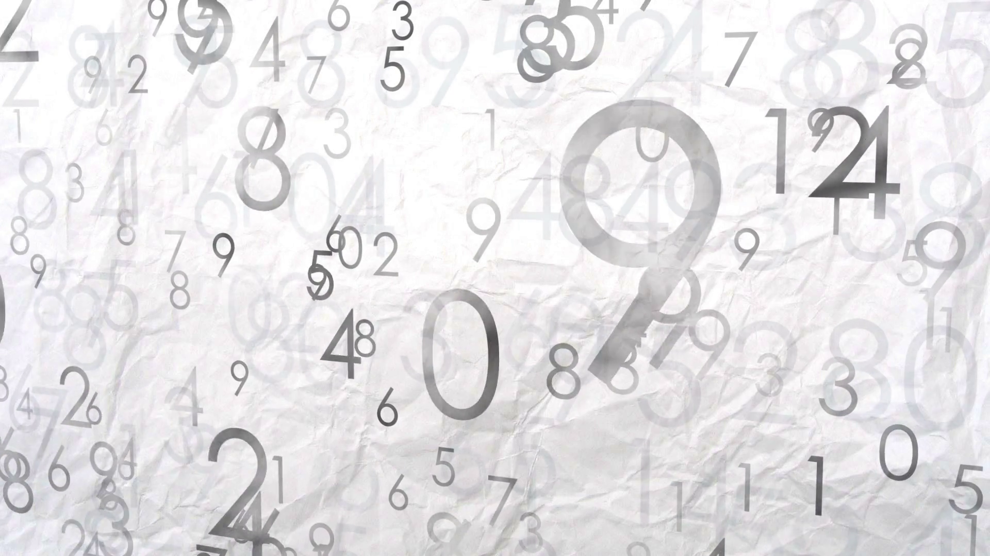
Handwritten Digit Identification
Austin Fisher
Roger Lorelli

Slide 2
Intro/Outline Slide
Sample Collection & Segmentation
Pre-Processing
Issues
CNN
Testing CNN
Analysis

Slide 3
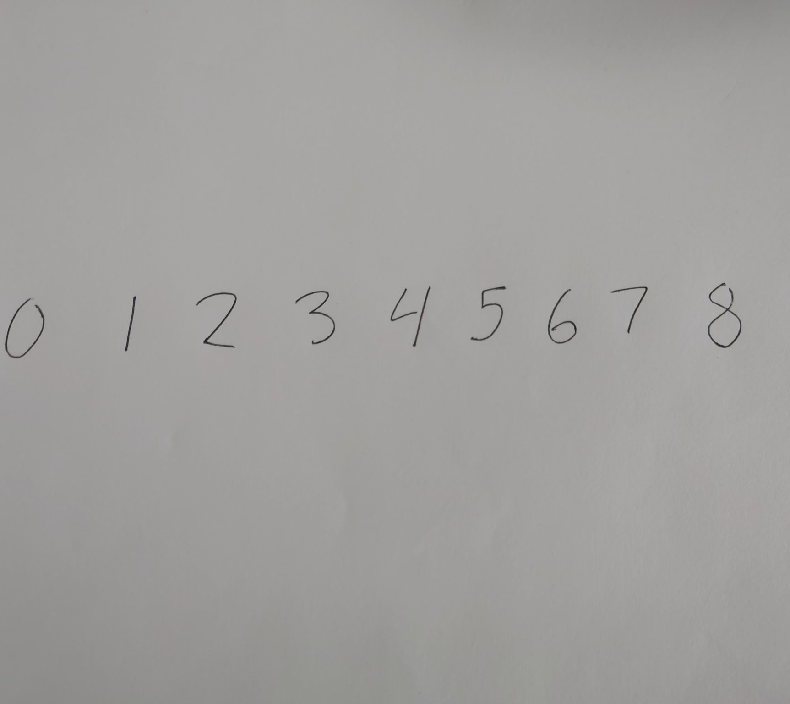
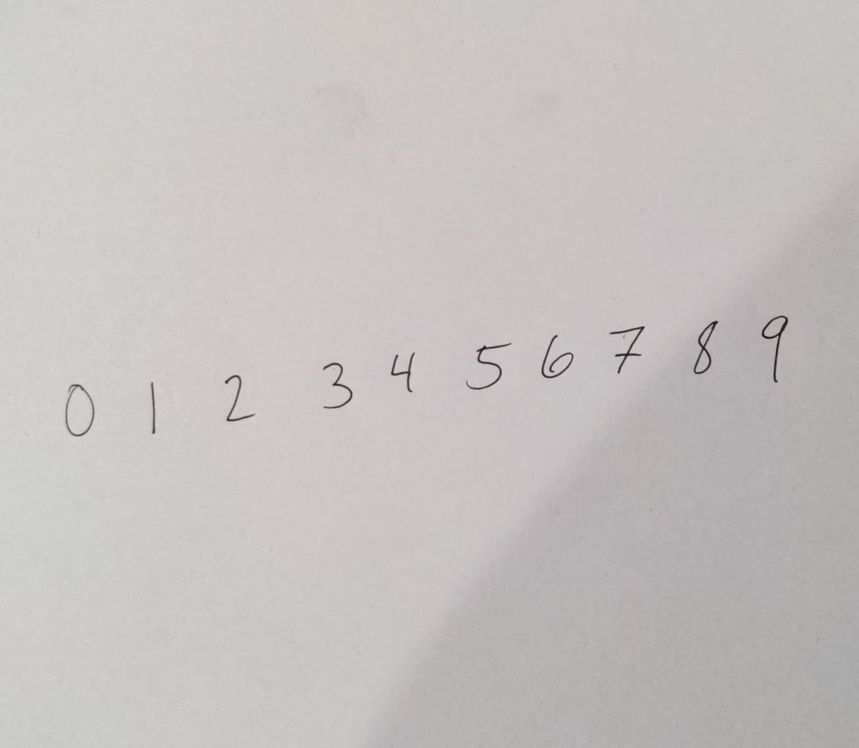
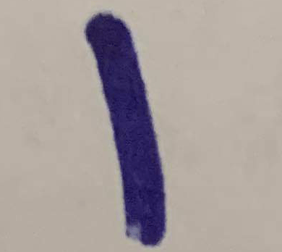

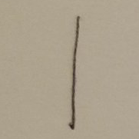
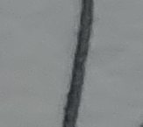
Sample Collection & Segmentation
Collected +40 strings of digits 0 – 9 from friends & family.
Using Photoshop, we cropped each digit out of the image, attempting to keep them to a uniform shape.

Slide 4
Pre-Processing - Matlab

Slide 5
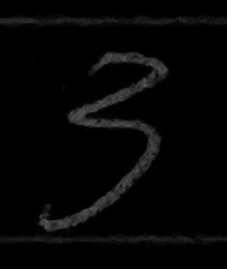
Pre-Processing Algorithm
Step 1: Set to grayscale & Background Subtraction

Slide 6
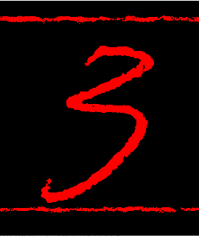
Pre-Processing Algorithm
Step 2: Thresholding using Otsu’s method

Slide 7
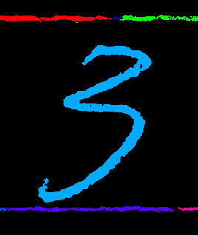
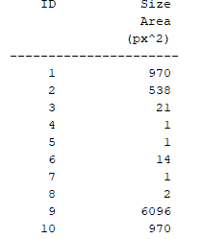
Pre-Processing Algorithm
Step 3: Label objects
Step 4: Measure in relation to size, i.e., Area

Slide 8

Pre-Processing Algorithm
Step 5: Find the largest object in the image & threshold for 5/6ths of the maximum objects area.

Slide 9



Issues With Preprocessing
Digits with disconnection parts were susceptible to having their smaller portions thresholded out of the image.

Slide 10

C Neural Network
Convolutional Layers
Feature Detection
Pooling Layers
Down sample the detection of features in feature maps
Flatten Layers
Reduce Dimensionality
Fully Connected Layers
Feature Selection

Slide 11
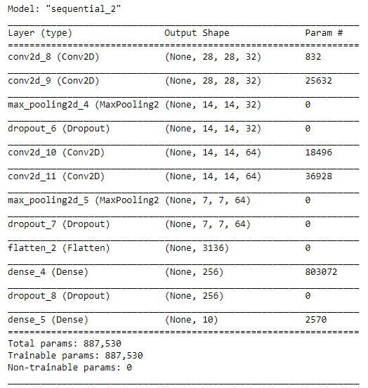
C Neural Network - Building

Slide 12
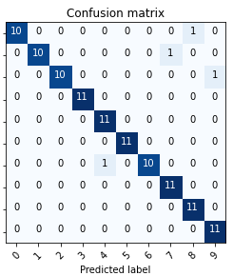
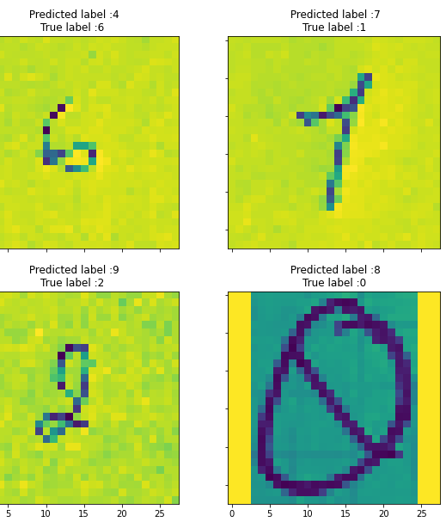
Test The System – Unprocessed Data Set

Slide 13
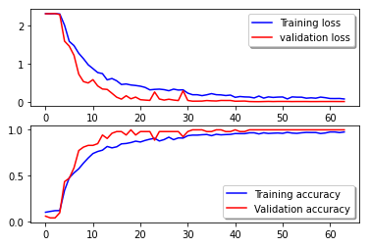
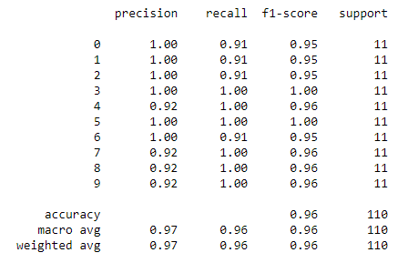
Analyzing Training Data vs. Test Data Unprocessed Data Set

Slide 14
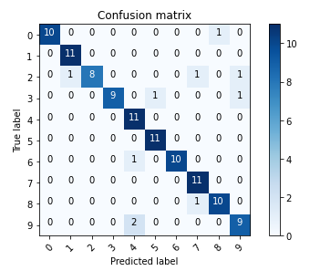
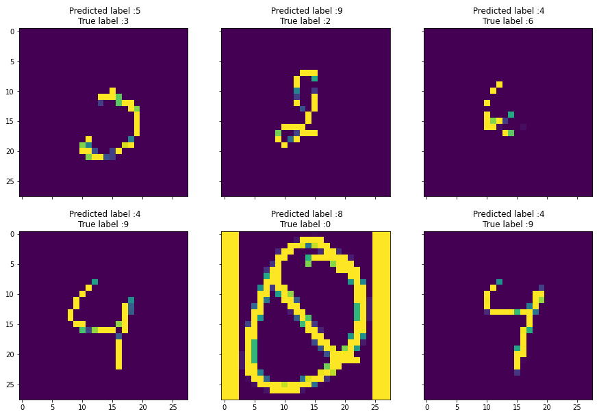
Test The System – Pre-Processed Data Set

Slide 15
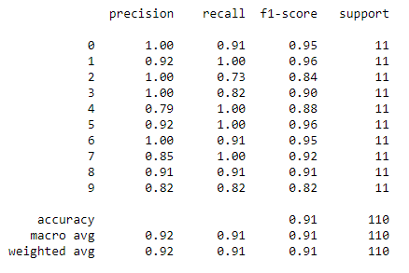
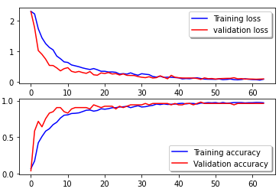
Analyzing Training Data vs. Test Data Pre-Processed Data Set

Slide 16

Thank You! Any Questions?

